Slide 1

Basic Knowledge On 3D Graphic
Jerome Peng

Slide 2

Contents
Section I
Introduction
Section II
Projection
Section III
Coordinate System
Section IV
Transfer
Section V
Hidden Surface
Section VI
Production

Slide 3


Session I
Introduction
2 types of 3D effect

Slide 4
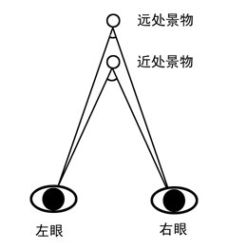
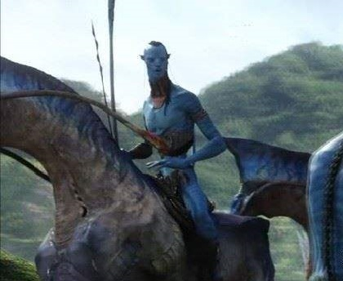
Session I
Introduction
3D movie

Slide 5
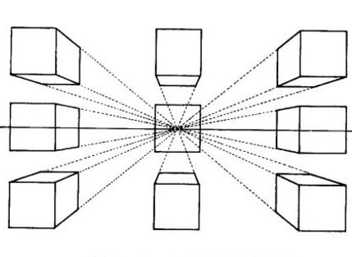
Session I
Introduction
3D game

Slide 6

Session II
Projection

Slide 7
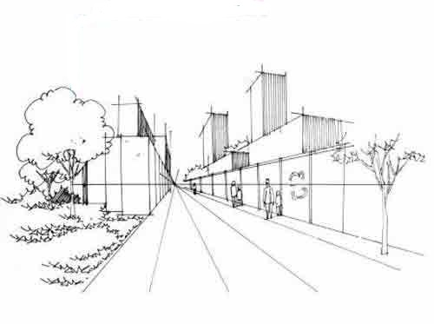
Session II
Projection

Slide 8
Session II
Projection

Slide 9
Session III
Coordinate System
z
y
x
y
x
y
x

Slide 10
Session III
Coordinate System
Key Point 1:
How to get the intersection between a line and a plane.
I used matrix to resolve this problem.
Solution as follow:
Line: p1(x1, y1, z1), p2(x2, y2, z2)
Vector of line: (vx, vy, vz) = (x2 - x1, y2 - y1, z2 - z1)
Plane: pp1(px1, py1, pz1), pp2(px2, py2, pz2), pp3(px3, py3, pz3)
Matrix:
Factor: (f1, f2, f3, f4)
Parameter: t = -((f1 + x2 * f2 + y2 * f3 + z2 * f4) / (f2 * vx + f3 * vy + f4 * vz))
Intersection: (x, y, z) = (t * vx + x2, t * vy + y2, t * vz + z2)

Slide 11
Thanks

